Slide 1
A Personal Financial Management App
PRESENTED BY:
Bathmapriya.P
Soundarya.K
Chandru.K
Akash.A

Slide 2
DESCRIPTION
Money Matters is a book that provides a comprehensive guide to personal finance, including budgeting, saving, investing, and credit and debt management. It offers practical tips and real-world examples.
A personal finance app is a software tool that can help users manage their finances more efficiently. It can help users:
Track bills and expenses
Calculate income and expenditure
Plan out a budget
Organize finances
Analyze data and generate insightful reports
Provide advice and insurance inputs
Help prepare for financial emergencies
Offer access to various investment options
Personal finance apps can be connected to a user's banking account to transfer data about their income and spending. They can also help users identify money management habits and patterns, and suggest ways to spend their disposable income.

Slide 3
Main Activity.java:
package com.example.expensestracker
import android.content.Context
import android.content.Intent
import android.os.Bundle
import androidx.activity.ComponentActivity
import androidx.activity.compose.setContent
import androidx.compose.foundation.Image
import androidx.compose.foundation.layout.*
import androidx.compose.material.*
import androidx.compose.runtime.*
import androidx.compose.ui.Alignment
import androidx.compose.ui.Modifier
import androidx.compose.ui.graphics.Color
import androidx.compose.ui.layout.ContentScale
import androidx.compose.ui.res.painterResource
import androidx.compose.ui.text.font.FontFamily
import androidx.compose.ui.text.font.FontWeight
import androidx.compose.ui.text.input.PasswordVisualTransformation
import androidx.compose.ui.tooling.preview.Preview

Slide 4
import androidx.compose.ui.unit.dp
import androidx.compose.ui.unit.sp
import androidx.core.content.ContextCompat
import com.example.expensestracker.ui.theme.ExpensesTrackerTheme
class RegisterActivity : ComponentActivity() {
private lateinit var databaseHelper: UserDatabaseHelper
override fun onCreate(savedInstanceState: Bundle?) {
super.onCreate(savedInstanceState)
databaseHelper = UserDatabaseHelper(this)
setContent {
ExpensesTrackerTheme {
// A surface container using the 'background' color from the theme
Surface(
modifier = Modifier.fillMaxSize(),
color = MaterialTheme.colors.background
) {
RegistrationScreen(this,databaseHelper)
}
}
}
}
}

Slide 5
@Composable
fun RegistrationScreen(context: Context, databaseHelper: UserDatabaseHelper) {
Image(
painterResource(id = R.drawable.img_1), contentDescription = "",
alpha =0.3F,
contentScale = ContentScale.FillHeight,
)
var username by remember { mutableStateOf("") }
var password by remember { mutableStateOf("") }
var email by remember { mutableStateOf("") }
var error by remember { mutableStateOf("") }
Column(
modifier = Modifier.fillMaxSize(),
horizontalAlignment = Alignment.CenterHorizontally,
verticalArrangement = Arrangement.Center
) {

Slide 6
Text(
fontSize = 36.sp,
fontWeight = FontWeight.ExtraBold,
fontFamily = FontFamily.Cursive,
color = Color.White,
text = "Register"
)
Spacer(modifier = Modifier.height(10.dp))
TextField(
value = username,
onValueChange = { username = it },
label = { Text("Username") },
modifier = Modifier
.padding(10.dp)
.width(280.dp)
)

Slide 7
TextField(
value = email,
onValueChange = { email = it },
label = { Text("Email") },
modifier = Modifier
.padding(10.dp)
.width(280.dp)
)
TextField(
value = password,
onValueChange = { password = it },
label = { Text("Password") },
modifier = Modifier
.padding(10.dp)
.width(280.dp),
visualTransformation = PasswordVisualTransformation()
)
if (error.isNotEmpty()) {
Text(

Slide 8
text = error,
color = MaterialTheme.colors.error,
modifier = Modifier.padding(vertical = 16.dp)
)
}
Button(
onClick = {
if (username.isNotEmpty() && password.isNotEmpty() && email.isNotEmpty()) {
val user = User(
id = null, firstName = username,
lastName = null,
email = email,
password = password
)
databaseHelper.insertUser(user)
error = "User registered successfully"
// Start LoginActivity using the current context
context.startActivity(
Intent(
context,
LoginActivity::class.java
)

Slide 9
)
} else {
error = "Please fill all fields"
}
},
modifier = Modifier.padding(top = 16.dp)
) {
Text(text = "Register")
}
Spacer(modifier = Modifier.width(10.dp))
Spacer(modifier = Modifier.height(10.dp))
Row() {
Text(
modifier = Modifier.padding(top = 14.dp), text = "Have an account?"
)
TextButton(onClick = {
context.startActivity(
Intent(
context,
LoginActivity::class.java
)

Slide 10
)
})
{
Spacer(modifier = Modifier.width(10.dp))
Text(text = "Log in")
}
}
}
}
private fun startLoginActivity(context: Context) {
val intent = Intent(context, LoginActivity::class.java)
ContextCompat.startActivity(context, intent, null)
}

Slide 11
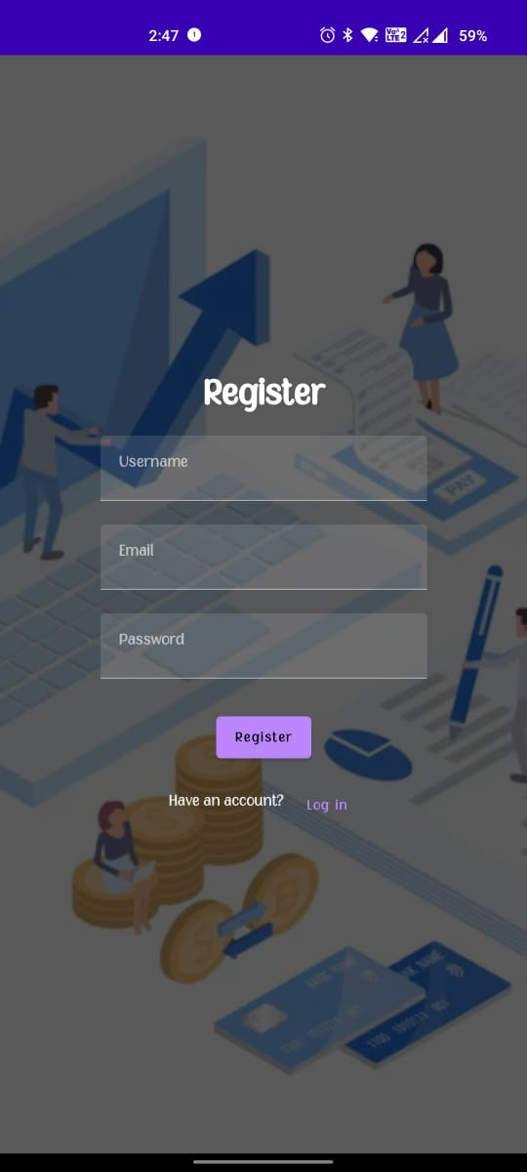

Slide 12
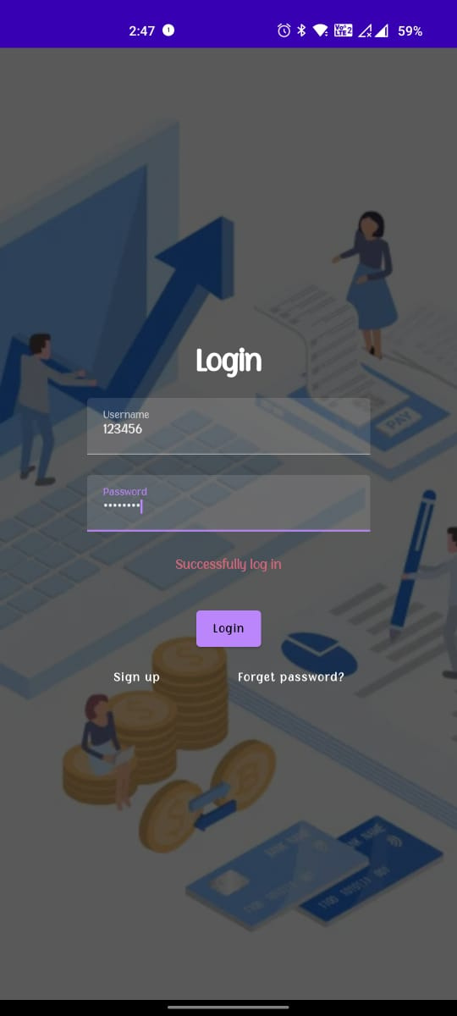

Slide 13
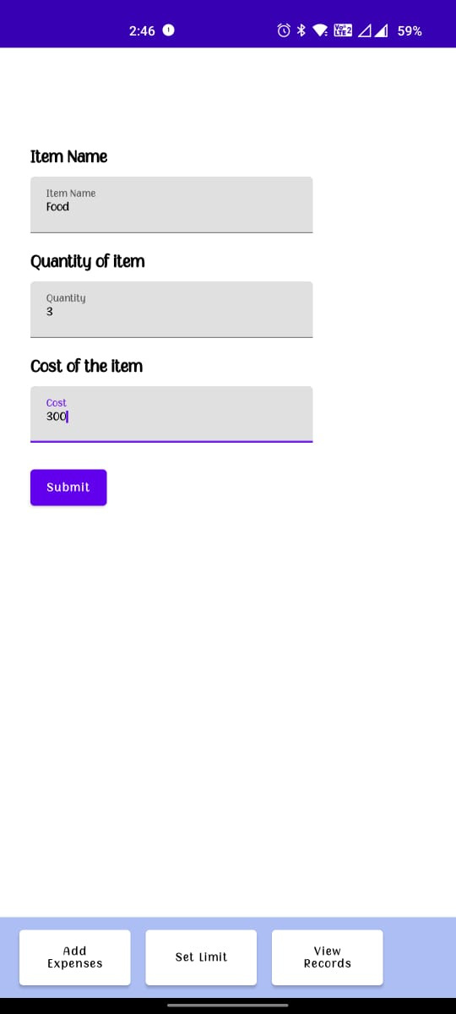

Slide 14
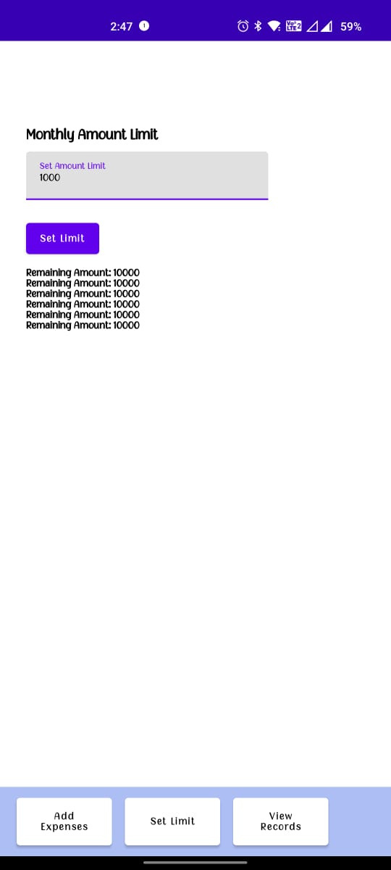

Slide 15
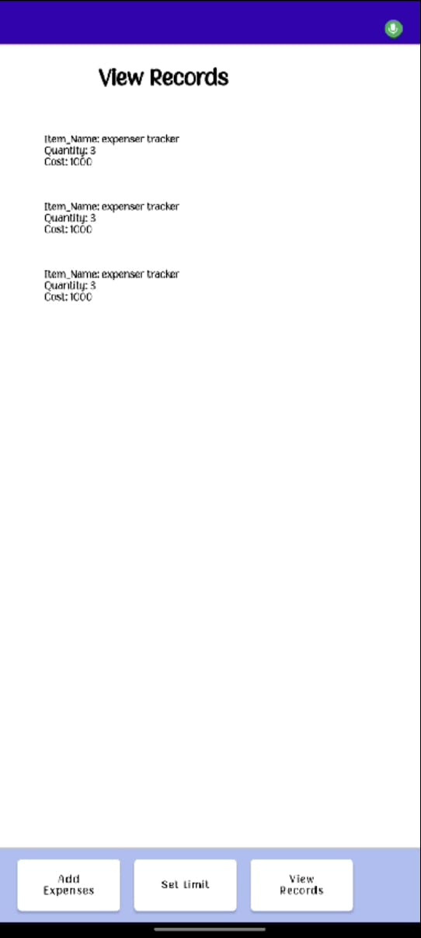

Slide 16
